Slide 1
GEOG0114: Principles of spatial analysis
WEEK 7: spatial models (part 1)
Dr Anwar Musah (a.musah@ucl.ac.uk)
Lecturer in Social and Geographic Data Science
UCL Geography
1

Slide 2
Contents
Regression-based models for causal and predictive inference
Standard Linear Regression (SLR)
Model Diagnostics of Residuals
Testing evidence for Spatial Dependence
Extending an SLR to Spatial Regression Model
Spatial lag
Spatial error
Methodology for model selection
We’ll cover an example of analysis and interpretation
Problem
Knowledge
Collect
Model
Wrangle
Explore
2

Slide 3

QUICK recap
We covered key concepts of spatial dependence i.e., the characteristics such spatial heterogeneity and autocorrelation
We covered what, why and how Spatial Weight Matrix (W) are important
Contiguity-based weights
Distance-based weights
How to measure globally and locally the degree of spatial dependence using the Moran’s I statistics
Let’s rewind a bit back on what was taught in Week 3
3

Slide 4
Spatial Models
Week 7
Week 8
Week 9
Spatial Lag and Error Models
Geographically Weighted Regression
Spatial Risk
Models
Week 3’s concepts on spatial dependence are heavily emphasised here for Spatial Lag and Error Models
4

Slide 5
What is a Regression model
5

Slide 6
Definition of a Regression model:
Regression is a mathematical formula that allows a user to perform two things:
To determine the relationship or association between a specified outcome (i.e., dependent variable) with one or more predictors (i.e., independent variable(s))
For making a prediction about an outcome (i.e., dependent variable) or making a projection or forecast of that outcome based on predictors.
1) Casual Inference
2) Predictive Inference
6

Slide 7
Casual & Predictive Inference
Examples of causal inference, i.e., the relationship between a dependent and independent variable(s):
What is the association between the incidence of skin cancer and exposure to long-term low-level elevated topsoil arsenic concentrations in the UK?
What impact does increased levels of socioeconomic deprivation have on the burden of crime rates?
What is the risk of a landslide associated with an increase in levels of rainfall, as well as soil texture in Bangladesh?
Examples of predictive inference, i.e., when we know relationship between dependent and independent variable(s) but use some model to forecast unobserved values:
What is the predicted incidence rate of skin cancer in the UK (at residential post code-level) when topsoil arsenic concentrations reach levels of 40 mg/kg
What is the estimated risk of a landslide event in Bangladesh when rainfall levels reach values > 50mm (2.0 inches) per hour
7

Slide 8
Let us clear the air with some terminology
Dependent Variable
This is the variable whose values we want to explain or forecast
Its value depend on something else
Interchangeable terms:
Dependent variable
Response variable
Outcome
Event
Independent Variable
This is the variable that explains our dependent variable. We can say it has an “impact”, or it is “associated” with our dependent variable
Its values are independent and used to explain the dependent variable
Interchangeable terms:
Independent variable
Explanatory variable
Exposure
Risk factor(s)
8

Slide 9
In terms of regression, there are several types of models, each with there own families depending on the type distribution for the dependent variable:
Here is a board overview:
Distribution of dependent variable | Suitable Model
Continuous measures: e.g., average income in postcode (£); concentrations of ambient particulate matter (PM2.5); Normalised Vegetative Difference Index (NDVI) etc., | Linear regression
Binary measures (1 = “present” or 0 = “absent”): e.g., A person voting for a candidate, Lung cancer risk, house infested with mosquitoes etc., | Logistic Regression
Binomial measure (or proportion): e.g., prevalence of houses in a postcode infested with mosquitoes, percentage of people in a village infected with intestinal parasitic worms, prevalence of household on a street segment victimised by crime etc., | Logistic Regression
Counts or discrete measures: e.g., number of reported burglaries on a street segment, number of riots in a county etc., | Poisson Regression
Time-to-event binary measures: e.g., Lung cancer risk due to chronic exposure to environmental levels of indoor radon. Risk of landslide and time dependence of surface erosion etc., | Survival Analysis with Cox regression
9

Slide 10
In terms of regression, there are several types of models, each with there own families depending on the type distribution for the dependent variable:
Here is a board overview:
Distribution of dependent variable | Suitable Model
Continuous measures: e.g., average income in postcode (£); concentrations of ambient particular matter (PM2.5); Normalised Vegetative Difference Index (NDVI) etc., | Linear regression
Binary measures (1 = “present” or 0 = “absent”): e.g., Person’s voting for a candidate, Lung cancer risk, house infested with rodents etc., | Logistic Regression
Binomial measure (or proportion): e.g., prevalence of houses in a postcode infested with rodents, percentage of people in a village infected with intestinal parasitic worms, prevalence of household on a street segment victimised by crime etc., | Logistic Regression
Counts or discrete measures: e.g., number of reported burglaries on a street segment, number of riots in a county etc., | Poisson Regression
Time-to-event binary measures: e.g., Lung cancer risk due to chronic exposure to environmental levels of indoor radon. Risk of landslide and time dependence of surface erosion etc., | Survival Analysis with Cox regression
10

Slide 11
Univariable & Multivariable Regression
11

Slide 12
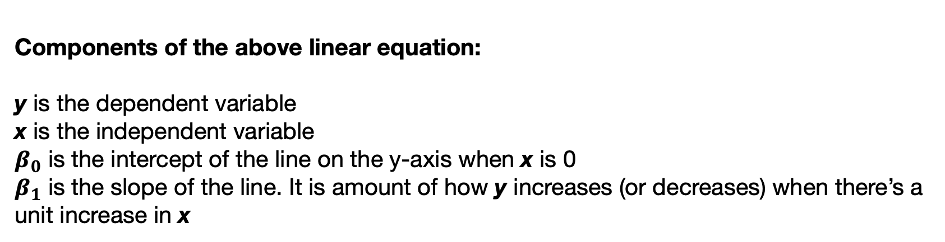
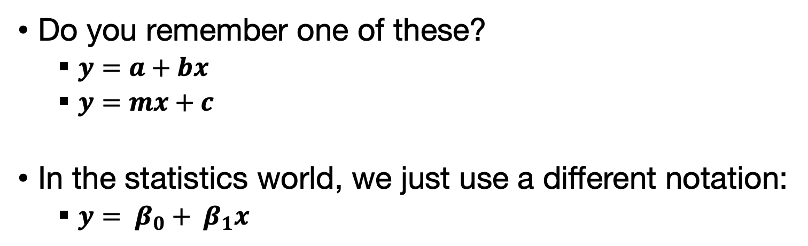
A Linear Equation
Do you remember one of these?
$y=a+bx$
$y=mx+c$
In the statistics world, we just use a different notation:
$y= β_{0}+ β_{1}x$
Components of the above linear equation:
y is the dependent variable
x is the independent variable
$β_{0}$ is the intercept of the line on the y-axis when x is 0
$β_{1}$ is the slope of the line. It is amount of how y increases (or decreases) when there’s a unit increase in x
12

Slide 13
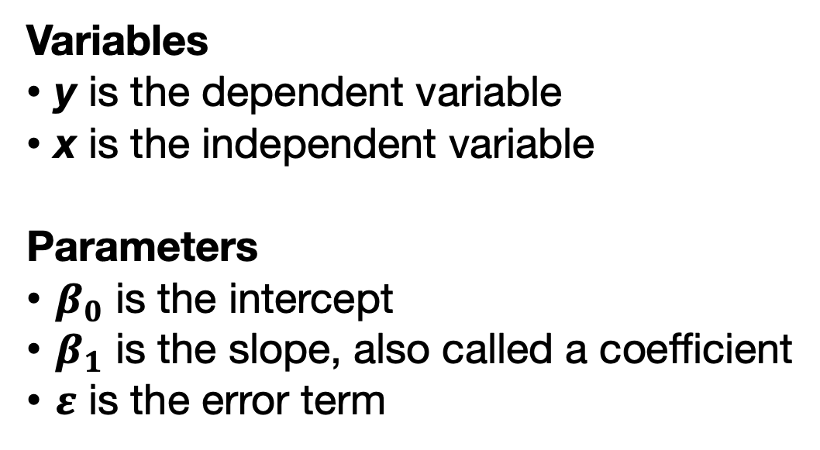
Simple Linear Regression Model
$$y= β_{0}+β_{1}x+ε$$
Variables
y is the dependent variable
x is the independent variable
Parameters
$β_{0}$ is the intercept
$β_{1}$ is the slope, also called a coefficient
$ε$ is the error term
13

Slide 14
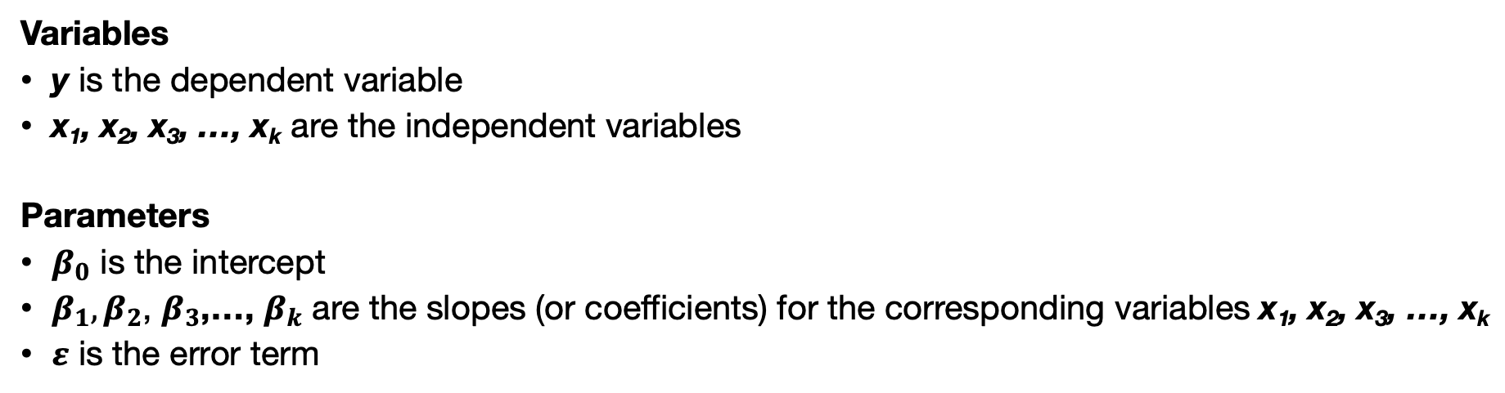
Multivariable Linear Regression Model
$$y= β_{0}+β_{1}x_{1}+β_{2}x_{2}+…+ε$$
Variables
y is the dependent variable
x₁, x₂, x₃, …, x_{k} are the independent variables
Parameters
$β_{0}$ is the intercept
$β_{1},β_{2}$, $β_{3}$,…, $β_{k}$ are the slopes (or coefficients) for the corresponding variables x₁, x₂, x₃, …, x_{k}
$ε$ is the error term
14

Slide 15
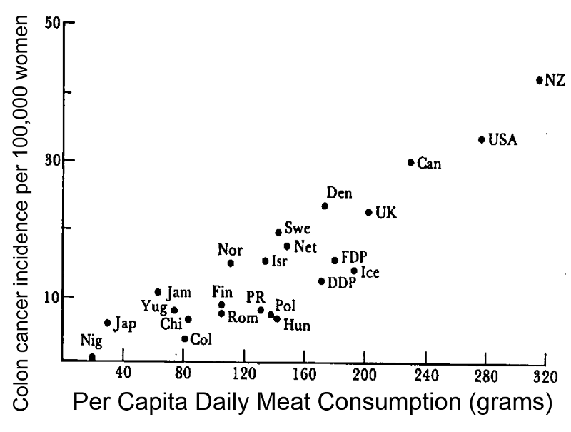
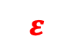
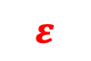
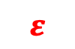
Simplest example of a univariable relationship
1. Notes:
Linear models are best for finding the best fit between predicted values and observed values y
Observed value is higher than predicted: positive residual (under-estimate)
$$ε$$
2. Notes:
a. Blue line – the predicted value for y and the black circles are the actual observed outcome.
b. The difference between the predicted and observed value give us the error term which called as residuals.
Such model comes with a set of assumptions
y
$$ε$$
Observed value is less than predicted: negative residual (over-estimate)
$$ε$$
$$ε$$
This model returns the actual value for y (Black dot): $y= β_{0}+β_{1}x_{1}+ε$
This returns the fitted line (blue) which is a prediction for y: $\hat{y}= β_{0}+β_{1}x_{1}$
15
Notes:
Describe the parts of this figure

Slide 16
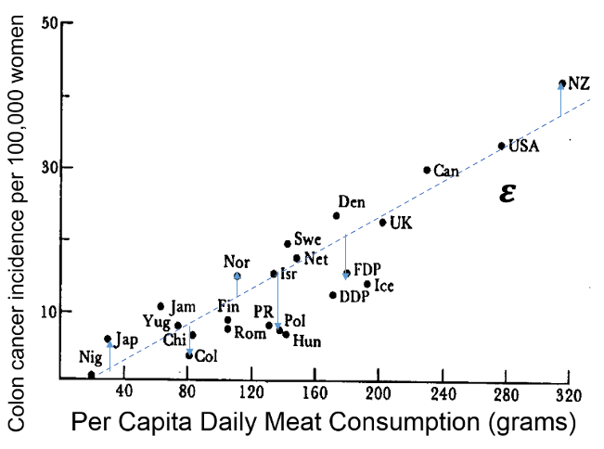



Assumptions of Linear Model
Notes:
Assumption 1: The random errors/ residuals should have a mean of zero.
Meaning that if we were to take the sum of these differences between the predicted y and observed y, and then divide it be the number of data points – this should give a mean estimate that should be zero.
Well, this assumption is saying that this sum should be approximately close to zero.
Assumption 2: The distribution of these errors/residuals must be normally distributed
Meaning that if we were to take these points and generate a histogram with them – these should give a shape that’s approximately akin to a bell-curve.
Assumption 3: The errors/residuals must have a constant variance (homoskedasticity) and must be uncorrelated.
What do we mean by this third assumption???
$$ε$$
y
$$ε$$
$$ε$$
$$ε$$
This model returns the actual value for y (Black dot): $y= β_{0}+β_{1}x_{1}+ε$
This returns the fitted line (blue) which is a prediction for y: $\hat{y}= β_{0}+β_{1}x_{1}$
16

Slide 17
Notes:
Assumption 3: The errors/residuals must have a constant variance (homoskedasticity) and uncorrelated.
What do we mean by this assumption???
When we take the residuals and plot them against the predicted Y (i.e., values of the line of goodness of fit) they should exhibit a patterns that appear like the image in panel (a).
17

Slide 18
Notes:
Assumption 3: The errors/residuals must have a constant variance (homoskedasticity) and uncorrelated.
What do we mean by this assumption???
When we take the residuals and plot them against the predicted Y (i.e., values of the line of goodness of fit) they should exhibit a patterns that appear like the image in panel (a).
If the patterns appear like this, then it’s safe to say that the variance in the errors are constant across the predicted values.
However, if is noisy like in panels b, c and d then there’s evidence of heteroskedasticity
18

Slide 19
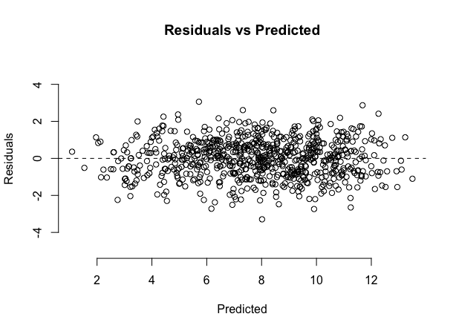
The points should be concentrated around the line when y = 0
Example plot of when the 3rd assumption is NOT violated
19
Notes:
The reason why I am touching residual assumptions – it’s a test we need to do when we want to use a regression on spatial data. If the assumptions are violated – we need to carry out a Moran’s I test for spatial dependence on the residuals.
I will come back to this later in the lecture.

Slide 20
The Beginning: Introduction to Spatial Analysis and Data Science
Spatial (Lag & Error) Linear Regression Model
20

Slide 21
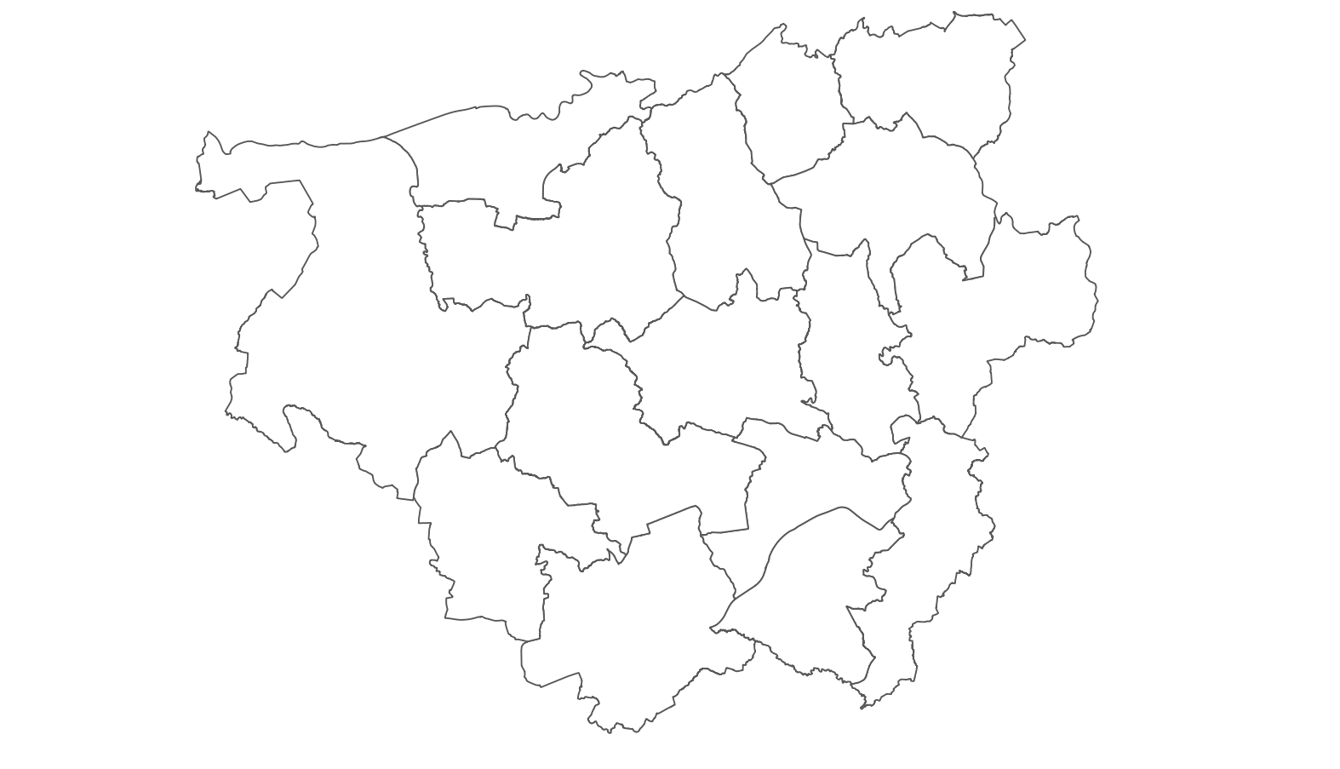
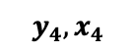
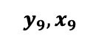
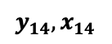
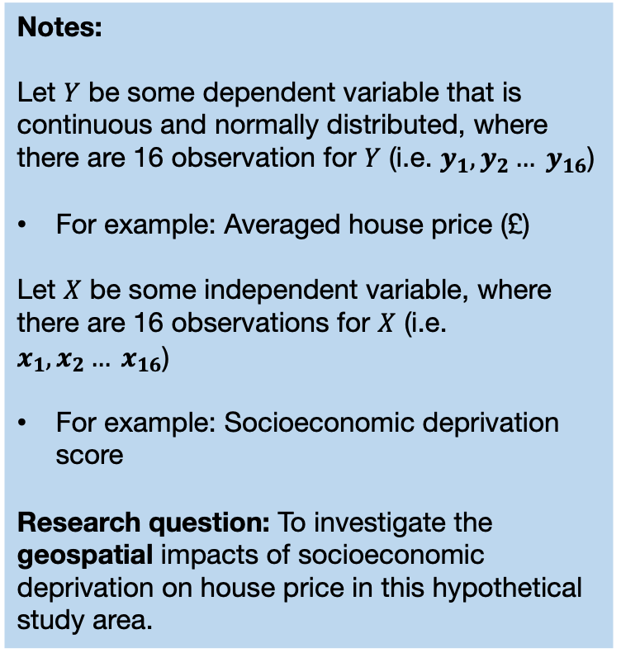
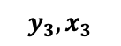
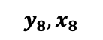
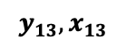
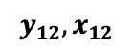
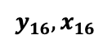
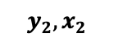
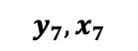
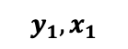
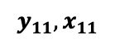
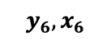
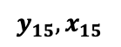
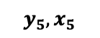
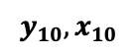
Suppose we have a hypothetical study area with 16 areas
Notes:
Let $Y$ be some dependent variable that is continuous and normally distributed, where there are 16 observation for $Y$ (i.e. $y_{1},y_{2}… y_{16}$)
For example: Averaged house price (£)
Let $X$ be some independent variable, where there are 16 observations for $X$ (i.e. $x_{1},x_{2}… x_{16}$)
For example: Socioeconomic deprivation score
Research question: To investigate the geospatial impacts of socioeconomic deprivation on house price in this hypothetical study area.
$$y_{6},x_{6}$$
$$y_{5},x_{5}$$
$$y_{2},x_{2}$$
$$y_{4},x_{4}$$
$$y_{7},x_{7}$$
$$y_{3},x_{3}$$
$$y_{1},x_{1}$$
$$y_{8},x_{8}$$
$$y_{9},x_{9}$$
$$y_{16},x_{16}$$
$$y_{15},x_{15}$$
$$y_{11},x_{11}$$
$$y_{14},x_{14}$$
$$y_{10},x_{10}$$
$$y_{12},x_{12}$$
Insufficient to use the typical linear regression model for this context
$$y_{13},x_{13}$$
$$y= β_{0}+βx+ε$$
21
Notes:
We are interested in modelling the direct relationship between y and x although we have spatial data.
One might be tempted to say “let’s implement a typical linear regression model and we’re sorted”

Slide 22
Scenario 1: The outcome of a location is influenced by other outcomes values from direct neighbours [1]
Notes:
One type of spatial dependency in this neighbourhood structure can be seen when a dependent variable (house price) for some neighbourhood (16) (y₁₆) is influenced by other house price dependent values from neighbouring areas (i.e., house prices values y₃, y₄ , y₉, y₁₁ and y₁₅) such as neighbourhoods 3, 4, 9, 11, and 16.
In this scenario, when the dependent variable’s outcomes from neighbouring areas have an influence on the outcome of a location, we call this type of spatial dependence a Spatial Lag on the dependent variable (aka Spatially lagged Y model)
Spatial Lag are suggestive of spatial spill overs or diffusion.
With spatial lags in a linear regression, the assumptions about independence, and observations being uncorrelated are always violated.
$$y_{6},x_{6}$$
$$y_{5},x_{5}$$
$$y_{2},x_{2}$$
$$y_{4},x_{4}$$
$$y_{7},x_{7}$$
$$y_{3},x_{3}$$
$$y_{1},x_{1}$$
$$y_{8},x_{8}$$
$$y_{9},x_{9}$$
$$y_{16},x_{16}$$
$$y_{15},x_{15}$$
$$y_{11},x_{11}$$
$$y_{14},x_{14}$$
$$y_{10},x_{10}$$
$$y_{12},x_{12}$$
$$y_{13},x_{13}$$
A hypothetical study area with 16 areas
22

Slide 23
Scenario 1: The outcome of a location is influenced by other outcomes values from direct neighbours [2]
Notes:
The same concept applies to all other areas, as well. While the house price values in neighbouring areas from y₃, y₄ , y₉, y₁₁ and y₁₅ are impacting influence it on y₁₆.
We can say the same thing is happening for all other areas. For instances, let consider y₉. This is going to be influenced by other house price values from its direct neighbours (i.e., y₄, y₇ , y₈, y₁₀ and y₁₁).
To reinforce, in this scenario, when the dependent variable’s outcomes from neighbouring areas have an influence on the outcome of a location, we call this type of spatial dependence a Spatial Lag on the dependent variable (aka Spatially lagged Y model)
$$y_{6},x_{6}$$
$$y_{5},x_{5}$$
$$y_{2},x_{2}$$
$$y_{4},x_{4}$$
$$y_{7},x_{7}$$
$$y_{3},x_{3}$$
$$y_{1},x_{1}$$
$$y_{8},x_{8}$$
$$y_{9},x_{9}$$
$$y_{16},x_{16}$$
$$y_{15},x_{15}$$
$$y_{11},x_{11}$$
$$y_{14},x_{14}$$
$$y_{10},x_{10}$$
$$y_{12},x_{12}$$
$$y_{13},x_{13}$$
A hypothetical study area with 16 areas
23

Slide 24
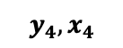
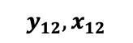
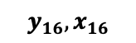
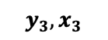
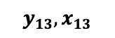
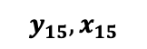
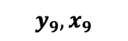
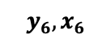
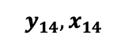
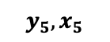
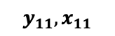
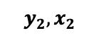
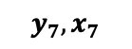
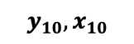
Scenario 2: Independent variable from the surrounding neighbourhoods have an influence on the values of the dependent variable
Notes:
Another type of spatial dependency in this neighbourhood structure can be seen when a dependent variable (house price) for some neighbourhood (16) (y₁₆) is influenced by the independent variable values (i.e., socioeconomic deprivation) from neighbouring areas (i.e., socioeconomic deprivation values x₃, x₄ , x₉, x₁₁ and x₁₅) measured in neighbourhoods 3, 4, 9, 11, and 16.
In this scenario, when the independent variable from neighbours influences the outcome of a location, we call this type of spatial dependence a Spatial Lag on the independent variable (aka Spatially lagged X model)
Again, such spatial lag of this sorts are suggestive of spatial spill overs or diffusion.
$$y_{6},x_{6}$$
$$y_{5},x_{5}$$
$$y_{2},x_{2}$$
$$y_{4},x_{4}$$
$$y_{7},x_{7}$$
$$y_{3},x_{3}$$
$$y_{1},x_{1}$$
$$y_{8},x_{8}$$
$$y_{9},x_{9}$$
$$y_{16},x_{16}$$
$$y_{15},x_{15}$$
$$y_{11},x_{11}$$
$$y_{14},x_{14}$$
$$y_{10},x_{10}$$
$$y_{12},x_{12}$$
$$y_{13},x_{13}$$
A hypothetical study area with 16 areas
24

Slide 25
Scenario 3: Both the values from the dependent and independent variable from the surrounding neighbourhoods have an influence on the value of the outcome
Notes:
The 3rd type of spatial dependency in this neighbourhood structure can be seen when a dependent variable (house price) for some neighbourhood (16) (y₁₆) is influenced by BOTH the values from the dependent and independent variable (i.e., house price and socioeconomic deprivation) from the surrounding neighbouring areas (i.e., socioeconomic deprivation values x₃, x₄ , x₉, x₁₁ and x₁₅ as well as house prices y₃, y₄ , y₉, y₁₁ and y₁₅) measured in neighbourhoods 3, 4, 9, 11, and 16.
In this scenario, when both the dependent and independent variable from neighbours influences the outcome of a location, we call this type of spatial dependence a Spatial Lag on the independent variable
Again, such spatial lag of this sorts are suggestive of spatial spill overs or diffusion.
$$y_{6},x_{6}$$
$$y_{5},x_{5}$$
$$y_{2},x_{2}$$
$$y_{4},x_{4}$$
$$y_{7},x_{7}$$
$$y_{3},x_{3}$$
$$y_{1},x_{1}$$
$$y_{8},x_{8}$$
$$y_{9},x_{9}$$
$$y_{16},x_{16}$$
$$y_{15},x_{15}$$
$$y_{11},x_{11}$$
$$y_{14},x_{14}$$
$$y_{10},x_{10}$$
$$y_{12},x_{12}$$
$$y_{13},x_{13}$$
A hypothetical study area with 16 areas
25

Slide 26
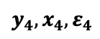
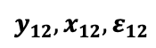
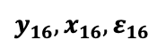
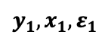
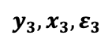
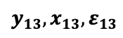
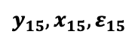
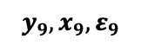








Scenario 4: The errors represent the unexplained or “independent variables” that are unaccounted across neighbourhoods impacting our dependent variable
Notes:
The last type of spatial dependency can occur when the error in the observed dependent variable (house price) from neighbouring areas where there’s some independent variable which we have not considered which is somehow having a major influence on the measured outcome in neighbourhood (16) (y₁₆).
Errors, in turn, can also influence each other, and can be correlated.
In this scenario, this type of spatial dependence is called Spatial Error
$$y_{6},x_{6},ε_{6}$$
$$y_{5},x_{5},ε_{5}$$
$$y_{2},x_{2},ε_{2}$$
$$y_{4},x_{4},ε_{4}$$
$$y_{7},x_{7},ε_{7}$$
$$y_{3},x_{3},ε_{3}$$
$$y_{1},x_{1},ε_{1}$$
$$y_{8},x_{8},ε_{8}$$
$$y_{9},x_{9},ε_{9}$$
$$y_{16},x_{16},ε_{16}$$
$$y_{15},x_{15},ε_{15}$$
$$y_{11},x_{11},ε_{11}$$
$$y_{14},x_{14},ε_{14}$$
$$y_{10},x_{10},ε_{10}$$
$$y_{12},x_{12},ε_{12}$$
$$y_{13},x_{13},ε_{13}$$
A hypothetical study area with 16 areas
26

Slide 27




Scenario 1
Scenario 2
Notes:
For these scenarios, where Y is the outcome, X are some independent variable(s) and E are residuals.
It possible to model the overall association, or relationships between X and Y, while considering:
1. Spatial configuration or layout of the for the study area.
2. The influences not only caused by the independent variables but also influences among the neighbouring outcome and error terms.
3. As well as quantifying the direct and indirectly relationship an independent variable will have on the outcome in a location, and in outcomes from neighbouring locations.
The linear regression can be extended into 4 different types of Spatial regression models which can feature a lag or error component.
Scenario 3
Scenario 4
27

Slide 28





Multivariable Linear Regression
$$y= β_{0}+β_{1}x_{1}+β_{2}x_{2}+…+β_{k}x_{k}+ε$$
1. Spatial Lag Model (lagged on the dependent variable)
$$y=ρWY {+ β}_{0}+β_{1}x_{1}+β_{2}x_{2}+…+β_{k}x_{k}+ε$$
2. Spatial Lag Model (lagged on the independent variable)
$$y={ β}_{0}+β_{1}x_{1}+β_{2}x_{2}+…+β_{k}x_{k}+θWX+ε$$
Scenario 1
Scenario 2
W is a spatial weights matrix (contiguity – based)
Y in the righthand side of the equation represents the observed outcome from other neighbouring areas (i.e., spatially lagged on Y)
$ρ$ “Rho” is the degree for how each measure for the outcome of (y) is influenced by its direct neighbours (for Y).
W is a spatial weights matrix (contiguity – based)
X in the righthand side of the equation represents the observed values of the independent variable from other neighbouring areas (spatially lagged on X)
$θ$ “theta” is the degree of how each measure of the outcome (y) is influenced by its direct neighbours (for X) measures.
28

Slide 29



Multivariable Linear Regression
$$y= β_{0}+β_{1}x_{1}+β_{2}x_{2}+…+β_{k}x_{k}+ε$$
3. Spatial Lag Model (lagged on both the dependent and independent variable)
$$y=ρWY {+ β}_{0}+β_{1}x_{1}+β_{2}x_{2}+…+β_{k}x_{k}+θWX+ε$$
4. Spatial Error Model
$$y={ β}_{0}+β_{1}x_{1}+β_{2}x_{2}+…+β_{k}x_{k}+λWu+ε$$
Scenario 3
Scenario 4
Refer to slide number 28 to see the meanings of each parameters
u are the correlated spatial error terms
$λ$ “lambda” estimated coefficient for the product W and u.
There is something spatial going on here that we have not accounted for!
29

Slide 30
Scenario 1
Scenario 2
Notes:
For these scenarios, where Y is the outcome, X are some independent variable(s) and E are residuals.
It possible to model overall association or relationships between X and Y, while considering:
1. Spatial configuration or layout of the for the study area.
2. The influences not only caused by the independent variables but also influences among the neighbouring outcome and error terms.
The linear regression can be extended into 4 different types of Spatial regression models which can feature a lag or error component, or both.
Scenario 3
Scenario 4
30

Slide 31
The Beginning: Introduction to Spatial Analysis and Data Science
Workflow for spatial regression modelling
31

Slide 32
Modelling process and model selection
When you want to conduct evidence-based analysis with spatial data – especially if the outcome is from a continuous distribution – you might want to follow these steps:
STEP 1: Carry some descriptive analysis to understand the underlying spatial distribution
STEP 2: Perform a Linear regression in order to assess the residuals for the model output to determine whether the assumptions of independence have been violated.
If there’s a violation:
STEP 3: Examine whether there is evidence of spatial dependence in the residuals using Moran’s I test.
If Moran’s I test is not significant – STOP! NO EVIDENCE OF SPATIAL DEPENDENCE HENCE NO NEED OF SPATIAL APPROACH
If Moran’s I test is significant and positive – then map the residuals accordingly to examine the spatial patterning of the residual.
STEP 4: Pick one of the spatial regression model and run its regression. For Spatial Lag Y (or X) Model were interested interpreting the “rho” (“theta”) estimates AND direct & indirect coefficients derived from the impacts() post estimation function.
For the Spatial Error model, it’s the “lambda” estimate. No need to use the impacts() function. We can get the coefficients directly from model.
STEP 5: Compare the AIC to see which is a better model between the spatial regression(s) and linear regression too. The one with lowest is better.
STEP 6: Perform the Moran’s I test on the spatial model to see if they have adequately accounted for spatial autocorrelation. The model with a not significant p-value is the best! Select that model for making your causal or predictive inference
If it’s significant (i.e, Moran’s I test) in step 6 – go for the one that has the lowest Moran’s I statistic closest to zero.
32

Slide 33

Example question: How does income, access to transportation
and socioeconomic deprivation impact house price?
Step 1: Descriptive Analysis
Average House Price (£) (Outcome)
Average Income (£) (Independent variable)
Socioeconomic deprivation score (Independent variable)
Public Transport Accessibility score (Independent variable)
33

Slide 34
Fitting a non-spatial model on spatial data for extracting the residuals
Step 2: Linear Regression Model
Variables | Coefficients | P-value
Intercept | -4.10 | < 0.05
log(IMDSCORE) | 0.136 | <0.05
log(Income) | 2.036 | <0.05
log(PTA Index) | 0.032 | <0.05
Explained variation in the model: 78.89%
Interpretation:
On a log transformed scale, if the INCOME was to increase by 1.0%, we expect the house prices to increase by 2.04% and this average increase is statistically significant since the p-value = 0.00000000002 <0.05.
On a log transformed scale, if the PTAINDEX was to increase by 1.0%, we expect the house prices to increase marginally by 0.03%. The marginally increase is statistically significant since the p-value = 0.000000000471 < 0.05.
On a log transformed scale, if the IMDSCORE was to increase by 1.0%, we expect the house prices to increase marginally by 0.13% and this average increase is statistically significant since the p-value = 0.00000000002 <0.05.
In terms of model performance: according to the Adjusted R-Squared value 0.7889 (78.89%)of the variation in the house prices across LSOAs were explained by the model after accounting for AVEINCOME, IMDSCORE, PTAINDEX. Since the Adjusted R-Squared more than 50.0% it is hence a very good model and significant (i.e., p-value = 0.0000000002 < 0.05).
34

Slide 35

Test for spatial dependency
Step 3: Plot the Residuals and Perform Moran’s I Test
Interpretation of residuals for linear regression model
Notice the spatial patterning and clusters of the LSOAs and the over-prediction (i.e., areas that have negative residuals, or blue tones) and under-prediction (i.e., areas that positive residuals, or red tones).
This visual inspection of the residuals is telling you that spatial autocorrelation may be present here. This, however, would require a more formal test.
Moran’s I = 0.475; p-value < 0.05
This is an indication that errors/residuals are
related and not independent. Spatial regression for this
output is needed.
35

Slide 36





Scenario 1: Spatial Lag Model (lagged on the dependent variable)
$$y=ρWY {+ β}_{0}+β_{1}x_{1}+β_{2}x_{2}+…+β_{k}x_{k}+ε$$
Step 4: Run a spatial regression model (lagged Y)
Estimate the $ρ$ coefficient for $WY$
Estimate the impacts i.e., the direct and indirect effects
$ρ$= 0.4522; p-value < 0.05
Interpretation:
The $ρ$ statistic informs us of how the neighbouring LSOA house price values affect the house price an index location (y). The ρ value is a positive value of 0.4522 which means the house price from neighbouring LSOAs have a positive manner, and it is statistically significant (i.e., p-value < 0.05).
We can see the AIC for the lag model is lower than the original linear regression model (i.e., Lag: -9863.3 vs LM: -8510.8) therefore the lag model is okay.
36

Slide 37
Step 5: Derive the direct and indirect coefficient values from the model
Interpretation of the relationship between our independent variables
and outcome from spatial regression model
 | Direct | Indirect | Total
log(IMD score) | 0.045% (p < 0.05) | 0.034 (p < 0.05) | 0.079% (p < 0.05)
log(Income) | 1.267% (p < 0.05) | 0.949 (p < 0.05) | 2.217% (p < 0.05)
log(PTA Index) | 0.011% (p < 0.05) | 0.008 (p < 0.05) | 0.019% (p < 0.05)
At specific location
At neighbouring
locations
Combined
Interpretation:-
Direct effect for deprivation: This means that for every unit increase in deprivation (on log-scale)
in a location (LSOA) leads to an average increase in the house prices by 0.045% in the same location, while accounting for spatial feedback (i.e., house price) from neighbouring locations (LSOAs) in London.
Indirect effect for deprivation: This means that for every unit increase in deprivation (on log-scale) in a location (LSOA) leads to average increase in the house prices by 0.034% in neighbouring locations, again, which accounting for its spillover effect through the spatial areas (LSOAs) in London.
37

Slide 38
Any questions?
38

